Slide 1
CANINE RESPIRATORY DISEASE COMPLEX
By: Denene M. Granger

Slide 2

C. R. D. C.
Canine Respiratory Disease Complex
There are several different ways dogs can acquire a respiratory disease, including the following:
Bacterial and Viral Infections
Immune-mediated reactions
Inhalation of irritant or toxins
Fungal Infections

Slide 3
Bacterial and Viral Infections
Bronchitis
Can be:
Acute or chronic
Infectious or non-infectious
Bacterial or Viral
Can be caused by:
Parasites
Smoke inhalation
Exposure to chemical fumes
Chronic non-infectious bronchitis is most common in older dogs, and breeds such as: beagles, poodles, and terriers.

Slide 4
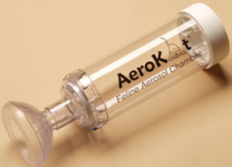
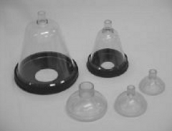
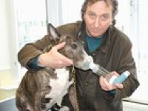
Tracheobronchitis aka
“Kennel Cough”
Is a chronic and highly contagious and can be caused by viral or bacterial infections. It can spread rapidly, but may clear up on its own. Puppies or young dogs with weakened immune systems could develop Bronchopneumonia.

Slide 5
Canine Influenza Virus
Natural Distribution
January 2004, the first recognized outbreak occurred at a greyhound racetrack in Florida.
June to August 2004, outbreaks were reported at 14 different racetracks in 6 states (Alabama, Arkansas, Florida, Kansas, Texas, and West Virginia).
January to May 2005, at 20 tracks in 11 states (Arizona, Arkansas, Colorado, Florida, Iowa, Kansas, Massachusetts, Rhode Island, Texas, and West Virginia).

Slide 6
Canine Influenza Virus
CIV has been documented in 30 states and Washington D. C., since that time.
Presently it is endemic in areas located in Colorado, Florida, New York, and Pennsylvania.
According to the Cornell University College of Veterinary Medicine Animal Health Diagnostic Center 1,079 cases of canine influenza were confirmed in October 2, 2008.

Slide 7
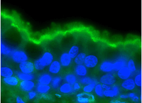
Canine Influenza Virus

Slide 8
Canine Influenza Virus
Transmission:
It is spread through aerosolized respiratory secretions and contaminated objects (collars, leashes, food dishes, water bowls, and kennel surfaces), as well as people moving between non-infected and infected animals.
The virus is viable for 48 hours on surfaces, 24 hours on clothing, and 12 hours on hands.

Slide 9
Canine Influenza Virus
Transmission continued:
From exposure to onset of clinical signs, the incubation period is usually 2 to 4 days.
Dogs are most contagious during this 2 to 4 day incubation period, and are not exhibiting any signs of illness.
During this time the highest amount of viral shedding occurs.

Slide 10
Canine Influenza Virus
Transmission continued:
During the first 4 days of illness, viral shedding decreases dramatically, but may continue from 7 to 10 days.
All dogs, regardless of breed or age, are susceptible to infection, since this is a newly emerging pathogen.
If the dogs acquire the milder form of canine influenza, they can recover without complications.

Slide 11
Canine Influenza Virus
Pathology and Clinical Signs
Infection and replication occurs inside the cells of the respiratory tract.
The epitheal cells lining the respiratory tract die during the pathological process, resulting in exposure of the underlying basement membrane.
Secondary bacterial infections occur which contributes to the coughing and nasal discharge.

Slide 12
Canine Influenza Virus
Pathology and Clinical Signs continued:
80% of infected dogs develop clinical signs.
20% of infected dogs not showing clinical signs, can still shed the virus and spread the infection.
CIV infections, unlike its human counterpart can occur year-round.
Mimics “kennel cough”, which frequently causes misdiagnosis.

Slide 13
Canine Influenza Virus
Pathology and Clinical Signs continued:
Can be mild or severe.
Despite treatment with antibiotics and cough suppressants, infected dogs have a cough that persists for 10 to 21 days.
The more severely affected dogs develop pneumonia, accompanied by a high-grade fever (104°F to 106 °F) with increased respiratory rate and effort.

Slide 14
Canine Influenza Virus
Diagnosis
Serologic testing is the most reliable and sensitive method for conformation of the illness.
As early as seven days after onset of clinical signs, antibodies may be detected in the blood.
During the first 4 days of illness it may be identified in nasal and pharyngeal swabs.

Slide 15
Canine Influenza Virus
Diagnosis continued:
Paired acute serum samples
(within the first 7 days).
Convalescent serum samples
(are taken 10 to 14 days later) necessary to diagnose recent infection.
PCR tests are peformed if the dog has been ill for less than 4 days, if done after 4 days it will not be as reliable.

Slide 16
Canine Influenza Virus
Morbidity
80% of the animals exposed, developed the disease.
Mortality
Greyhounds that developed hemorrhagic pneumonia during outbreaks, had a higher case of fatality rates.

Slide 17
Canine Influenza Virus
Prevention and Control
The virus can be easily killed by disinfectants.
If the dogs are showing clinical signs, isolation protocols, should be rigorously applied.
Dog owners should not bring their dogs that are exhibiting other signs of respiratory disease to facilities where other dogs could be exposed to the virus.
The vaccine is a “lifestyle” vaccine.

Slide 18
Canine Distemper
Most highly contagious and significant of the viral diseases of dogs.
It is caused by the Paramyxovirus, similar to the one that causes measles in humans and rinderpest in hoofed-animals.
Dogs at any age are susceptible to this virus (other animals that can be affected are: binturong, cats, and skunks).
Due to their underdeveloped immune systems, younger dogs are more vulnerable to the virus.

Slide 19
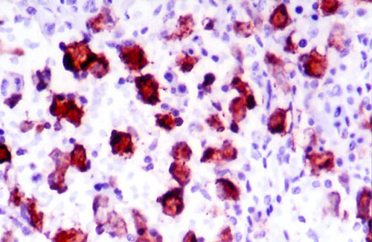
Canine Distemper

Slide 20
Canine Distemper
Signs and Symptoms
Due to its universal and wide range of clinical manifestations, it is usually confused with other diseases.
Gastrointestinal
Respiratory in nature (dyspnea)
Transient fever
Dramatic and sporadic increases in body temperature.

Slide 21
Canine Distemper
Signs and Symptoms
Behavioral changes (depression, lethargy, and weakness).
Neurological signs (muscle twitching, especially near the legs and mouth), as well as seizures and paralysis.
Dogs can develop a unique skin sign (hardening of the nose pad and footpads) mainly in older dogs.
With this disease, sudden death is not uncommon.

Slide 22
Canine Distemper
Diagnosis
Blood test are recommended to detect and confirm not only the disease, but also its severity.
Prevention
The disease is rampant in unvaccinated dogs.
Begin vaccination as early as 6 weeks of age.
Booster shots administered yearly
Quarantine infected animals.

Slide 23
Canine Distemper
Treatment
If preventive measures are performed treatment becomes irrelevant.
Early detection can increase chances of recovery.
In order to lessen any detrimental effects of opportunistic secondary bacterial infections, antibiotics may be prescribed.

Slide 24
http://www.caninedistemper.org/
http://www.avma.org/
Dog Respiratory Diseases/eHow.com
http://www.ehow.com/list_6568475_dog-respiratory-diseases.html#ixzz1RRW026GZ
http://canyonanimalhospitalphoenix.com/caninebrochitis.html

